Slide 1

CSE (H) with specialization in Machine Learning and Artificial Intelligence
Soft Computing (CSF – 332)
Chapter -2.2
Neural Network Optimization Methods
By: Dr. Monika Singh E11032
DISCOVER . LEARN . EMPOWER

Slide 2
Course Objectives
To introduce soft computing concepts and techniques of artificial neural networks, fuzzy sets, fuzzy logic and genetic algorithms
To understand the various techniques from the application point of view.
To analyze various soft computing techniques and decide the technique to be used in a particular problem situation.
To implement soft computing based solutions for real-world problems

Slide 3
Course Outcomes
CO1 | Identify and describe soft computing techniques and their roles in building intelligent. Machines | 1
CO2 | Recognize the feasibility of applying a soft computing methodology for a particular problem. | 2,4
CO3 | Apply fuzzy logic and reasoning to handle uncertainty and solve engineering problems, genetic algorithms to combinatorial optimization problems and neural networks to pattern classification and regression problems. | 3
CO4 | Effectively use modern software tools to solve real problems using a soft computing approach. | 3
CO5 | Evaluate various soft computing approaches for a given problem. | 4

Slide 4
Table of Contents
Loss functions and optimization
Cross entropy loss
Activation function

Slide 5
Neural Network Optimization Methods

Slide 6
Cross Entropy loss
It measures the performance of a classification model whose output is a probability value between 0 and 1.
Cross-entropy loss increases as the predicted probability diverges from the actual label.
So predicting a probability of .012 when the actual observation label is 1 would be bad and result in a high loss value. A perfect model would have a log loss of 0.

Slide 7
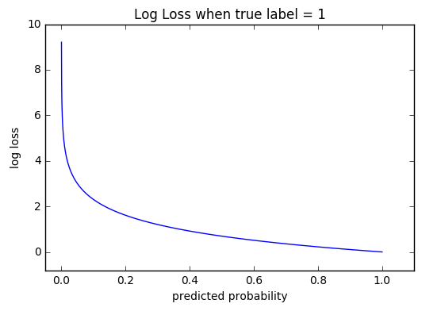
Continue:

Slide 8


Continue:
M — number of classes (dog, cat, fish) log — the natural log y — binary indicator (0 or 1) if class label cc is the correct classification for observation o p — predicted probability observation o is of class c
if M=2, means binary classification
M>2M>2 (i.e. multiclass classification), we calculate a separate loss
for each class label per observation and sum the result.

Slide 9
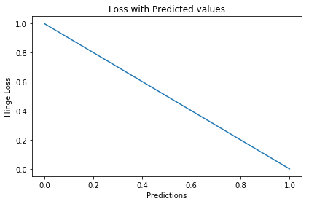

Hinge loss function:
An alternative to cross-entropy for binary classification problems is the hinge loss function, primarily developed for use with Support Vector Machine (SVM) models.

Slide 10
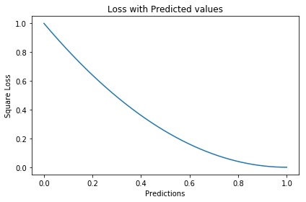
Square loss function:
A popular extension is called the squared hinge loss that simply calculates the square of the score hinge loss. It has the effect of smoothing the surface of the error function and making it numerically easier to work with.

Slide 11
Summary
Requirement of loss functions is being discussed. There are two categories of loss function, i.e., classification loss and regression loss. Classification loss is discussed.

Slide 12
Questions…
What do mean by loss functions
What is the difference between classification and regression loss?
What do you understand by cross entropy loss?

Slide 13

References
Book:
S.N.Sivanandam, S.N Deepa, “Principles of Soft Computing”
Websites:
https://nptel.ac.in/courses/106/105/106105173/
Videos:
https://www.youtube.com/watch?v=mlfM4SGOAgo

Slide 14
THANK YOU
For queries
Email: monika.e11032@cumail.in

